Slide 1
Stop Smoking Services - an effective tool for making life better Public Health Annual Conference Belfast 10th June 2015
Gerry Bleakney - PHA Strategic Lead for Tobacco Control
gerry.bleakney@hscni.net
Gillian Gilmore – Health Intelligence Manager
gillian.gilmore@hscni.net

Slide 2
1 in 2
Cigarettes are the only legal product when used as intended will kill half of its users. Also responsible for 50% of inequalities in health.

Slide 3
In Northern Ireland
2,300 people die prematurely from smoking related illnesses every year.
22% of population smoke (319,000), 23% males 21% females – 34% of most deprived and 12% of least deprived quintile.
Accounts for 16% of all deaths, 6 people per day
Identified in the Tobacco Strategy, TYC and Making Life Better as significant issue for inequalities – around 50%
Notes:
Half of all regular cigarette smokers will eventually be killed by their habit
Each cigarette smoked shortens the smokers life span by 5 minutes –
on average the smokers life by 10-15 years
Since 1983, male smoking prevalence has declined from 39% to 24%
Female smoking prevalence has fallen from 29% to 24% over the same period
Smoking prevalence was higher in 2009/10 among adults living in the most
deprived areas(41%) compared to adults living in the least deprived areas (13%)
Prevalence
Based on information at 2009/10, 22% of the Southern LCG population (aged 16+) smoked
cigarettes (West = 27%, Belfast and North = 24%, South East = 23% and NI = 24%).
Source: NISRA (Central Survey Unit), Continuous Household Survey 2009/10Heart Disease
USA 20% (2007)
Australia 18% (2004)
Canada 19% (2005)

Slide 4
Services
645 providers – specialist training, meet Quality Standards and use Elite System (com pharmacy/acute/primary care/community/workplaces)
Website – www.want2stop.info
Quit Kit and materials
Facebook and SMS
Notes:
LES across NI since 2013/14 -

Slide 5
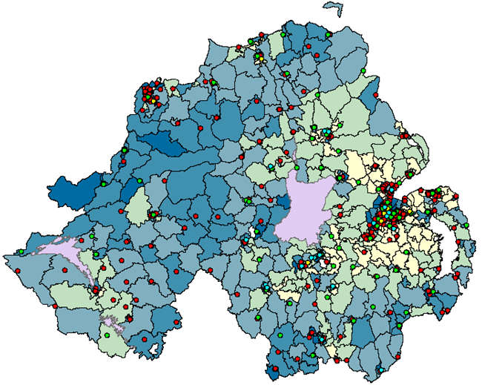
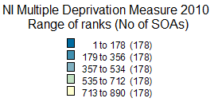
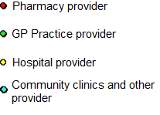
Number and location of Stop Smoking Service providers (2013/14) by provider type across Northern Ireland by super output area* multiple deprivation measure (MDM)
Source: Stop Smoking Services Database 2013/14
Reproduced with the permission of Land and Property Services under delegated authority from the Controller of Her Majesty’s Stationery Office, © Crown copyright and database rights NIMA ES&LA 210.3

Slide 6
Number and proportion of all NI smokers accessing Stop Smoking Services in Northern Ireland, 2009/10 – 2013/14.
Source: PHA NI Stop Smoking Services annual report 2013/14 (unpublished).

Slide 7
Four week self reported quit rates (and corresponding uptake) in the UK, 2013/14, (Wales 2012/13).
Uptake = 6,299
Uptake =103,431
Uptake =26,870
Uptake =586,337
Source: PHA Annual Stop Smoking Services report 2013.14.

Slide 8
Access and effectiveness of Stop Smoking Services among R + M workers 2011/12-2013/14.
 | 2011/12 | 2012/13 | 2013/14
Numbers accessing service (n) | 10009 | 8221 | 6965
Est. proportion of all R & M smokers accessing services (%) | 8.1 | 6.9 | 6.2
Number of R & M smokers quitting at 4 weeks (n) | 5575 | 5065 | 4330
4 week quit rate (%) | 55.7 | 61.6 | 62.2
52 week quit rate (% based on all accessing services) | 19.6 | 23.6 | -
Est. proportion of all R & M smokers quitting at 52 weeks (%) | 1.6 | 1.6
Source: Cited in PHA Annual Stop Smoking Services report

Slide 9
Number and estimated proportion of smokers accessing Stop Smoking Services within each deprivation quintile 2012/13-2013/14 (aged 16+).
Estimated proportion of smokers in each deprivation quintile accessing services (%)
Source: NI Stop Smoking Services annual report 2013/14 (unpublished)

Slide 10
Effectiveness of Stop Smoking Services within the deprivation quintiles 2012/13-2013/14 (aged 16+)
Most deprived Least deprived
 | 1 | 2 | 3 | 4 | 5
4 week quit rate 2013/14 | 57.3 | 58.5 | 58.1 | 62.1 | 58.8
4 week quit rate 2012/13 | 54.7 | 56.5 | 57.7 | 58.5 | 57.8
Estimated proportion of all smokers in NI quitting at 4 weeks (2013/14) | 4.6 | 4.4 | 4.4 | 4.4 | 3.6
52 week quit rate (based on all) 2012/13 | 17.5 | 21.5 | 21.9 | 20.6 | 20.6
Estimated proportion of all smokers in NI quitting at 52 weeks (2012/13) | 1.5 | 1.9 | 1.7 | 1.6 | 1.7

Slide 11
Responsive, accessible, high quality services are effectively used by disadvantaged individuals
Stop smoking services can help address inequalities in health and wellbeing
www.want2stop.info

