Slide 1
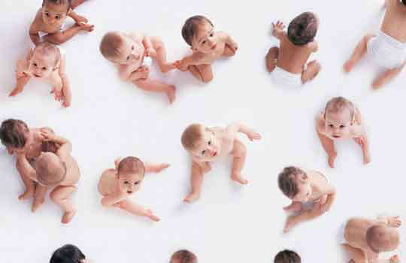
Respiratory syncytial virus (RSV) immunisation for pregnant women for the protection of infants
Acknowledgments to UK Health Security Agency (UKHSA) for use of their training slides

Slide 2
Contents
Key messages
Respiratory syncytial virus (RSV); symptoms, complications and epidemiology
RSV immunisation programme for pregnant women
Vaccine specific information
Additional resources

Slide 3
Key messages
Respiratory syncytial virus (RSV) is a major cause of respiratory illness in the population, accounting for approximately 33,500 hospitalisations annually in children aged under 5 years old
RSV can be particularly dangerous for infants and the elderly population, who are more likely to require intensive care admission
RSV results in 20 to 30 infant deaths per year in the United Kingdom (UK)
Notes:
National RSV vaccination programme announced - GOV.UK (www.gov.uk)

Slide 4
Key messages (continued)
RSV vaccines have been developed, and they have now been rigorously tested for safety and efficacy
the Joint Committee for Immunisation and Vaccination (JCVI) recommend RSV vaccination in pregnant women from 28 weeks gestation for the protection of their infant
RSV vaccination should be offered throughout the year, and in each new pregnancy, to offer the best protection to the baby
the universal RSV vaccination programmes are projected to have substantial health benefits; saving lives and significantly reducing burden on the National Health Service (NHS) during the challenging winter months
Notes:
National RSV vaccination programme announced - GOV.UK (www.gov.uk)

Slide 5
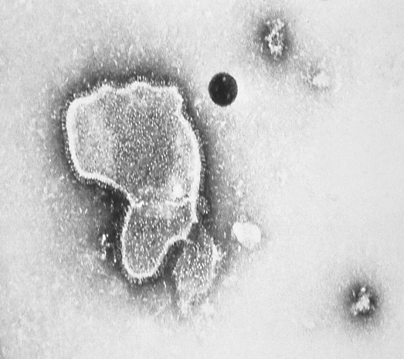
Respiratory syncytial virus (RSV)
Respiratory syncytial virus (RSV) is a single-stranded RNA virus that is a common cause of respiratory tract infections
humans are the only known reservoir of RSV
RSV is highly infectious and is transmitted via respiratory droplets (coughing and sneezing), through close contact with an infected person, or contact with contaminated surfaces
the incubation period varies from 2 to 8 days (average 3 to 5 days)
the virus usually causes mild, cold-like symptoms, however it can cause very serious infection in the young (infants) and the elderly, who are at increased risk of acute lower respiratory tract infection
RSV is best known for causing bronchiolitis in infants
RSV virion highly magnified by
transmission electron microscopic
Image courtesy of the CDC
Notes:
The incubation period is considered to range from 2 - 8 days and infectious period from 3 – 8 days.
The virus is spread from respiratory secretions through close contact with infected persons via respiratory droplets or contact with contaminated surfaces or objects.
Respiratory syncytial virus: the green book, chapter 27a - GOV.UK (www.gov.uk)
Bronchiolitis | nidirect

Slide 6
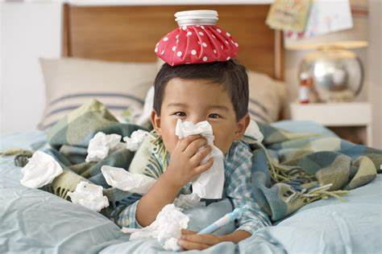
Symptoms of RSV
For most people, RSV infection causes a mild respiratory illness.
Acute respiratory symptoms can include;
rhinitis (runny nose)
cough
shortness of breath
wheeze
lethargy
decreased appetite
fever.
Notes:
RSV is a common cause of respiratory tract infections. It usually causes a mild self-limiting respiratory infection in adults and children, but it can be severe in infants and older adults who are at increased risk of acute lower respiratory tract infection, including bronchiolitis in infants.

Slide 7
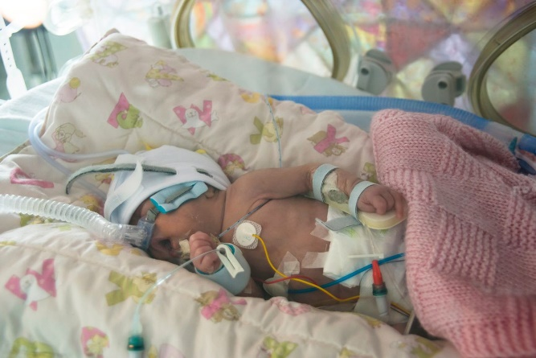
Complications of RSV
In infants, RSV can cause bronchiolitis (inflammation and narrowing of the small airways in the lungs), which can lead to hospitalisation due to significant breathing and feeding difficulties.
Other paediatric complications of RSV infection can include;
apnoea
hypoxemia
cardiovascular abnormalities
(such as tricuspid regurgitation
and arrythmias)
pneumonia
secondary bacterial infections.
In severe cases RSV infection can be fatal in infants.
Notes:
Infants with severe bronchiolitis from RSV may need intensive care and the infection can be fatal.
RSV associated infant mortality is highest in low- and middle-income countries, but RSV has a significant disease burden and related healthcare admissions in the UK.
Green Book on Immunisation chapter 27a Respiratory syncyntial virus (RSV) (publishing.service.gov.uk)

Slide 8
Complications of RSV (continued)
children most at risk of developing severe RSV infection are very young infants born prematurely who have predisposing conditions
however, most RSV hospital admissions occur in full-term babies without underlying clinical risk factors
children who have RSV bronchiolitis in early life may be at increased risk of developing asthma later in childhood (it may be that some children are more susceptible to both), and are at increased risk of recurrent wheezing
RSV in older children is associated with croup and otitis media (middle ear infection)
RSV lower respiratory tract infection can result in pneumonia in all age groups
Notes:
Respiratory syncytial virus: the green book, chapter 27a - GOV.UK (www.gov.uk)

Slide 9
High risk groups for RSV (children)
infants (under 1 year of age) are at the greatest risk from RSV
while most RSV infections usually cause mild illness, infants aged less than 6 months are at the highest risk of complications, such as bronchiolitis and pneumonia, which may result in hospitalisation
children born prematurely, who have predisposing conditions such as; congenital heart disease, chronic lung disease, chromosomal abnormalities, neuromuscular disorders, large airway abnormalities, and immunodeficiency, particularly multimorbidity, are at increased risk of developing severe, and occasionally fatal disease
Notes:
Birth months August to November are a risk factor for hospital admission due to RSV infection; these infants are younger, with correspondingly smaller airways, during peak RSV seasonal activity and have less well-developed immune systems than older infants. Social and demographic risk factors associated with severe RSV disease include being male, exposure to environmental tobacco smoke or indoor air pollution, having young siblings, and day care attendance.
Clinical risk factors for severe RSV infection in infants include prematurity, severe congenital heart disease, chronic lung disease of prematurity and severe combined immunodeficiency (SCID).
In children considered high risk due to prematurity or chronic respiratory disease, hospitalisation with RSV has a risk of death of around 3%.
Respiratory syncytial virus: the green book, chapter 27a - GOV.UK (www.gov.uk)

Slide 10
RSV epidemiology
RSV infection occurs throughout the year, however, activity is higher in winter, with a typical RSV season in the UK starting in October, peaking in December and declining by March
there is a significant burden of RSV illness in the UK population, with corresponding impacts on NHS services during the winter months
RSV accounts for approximately 33,500 hospitalisations annually in children aged under 5 years old, most commonly due to bronchiolitis
RSV is a leading cause of infant mortality globally, and results in 20 to 30 deaths per year in the UK
RSV infects up to 90% of children within the first 2 years of life and frequently re-infects older children and adults
previous infection with RSV results in only partial immunity to the virus, therefore individuals can be infected repeatedly throughout their life course
Notes:
At least half of children in the UK experience an RSV infection in the first year of life, and almost all will have experienced infection with RSV by the age of two.
Previous infection by RSV confers only partial immunity to RSV and so individuals may be infected repeatedly with the same or different strains of RSV.
UKHSA monitors levels of RSV activity in England throughout the RSV season, and data are available at gov.uk/government/collections/weekly-national-flu-reports

Slide 11
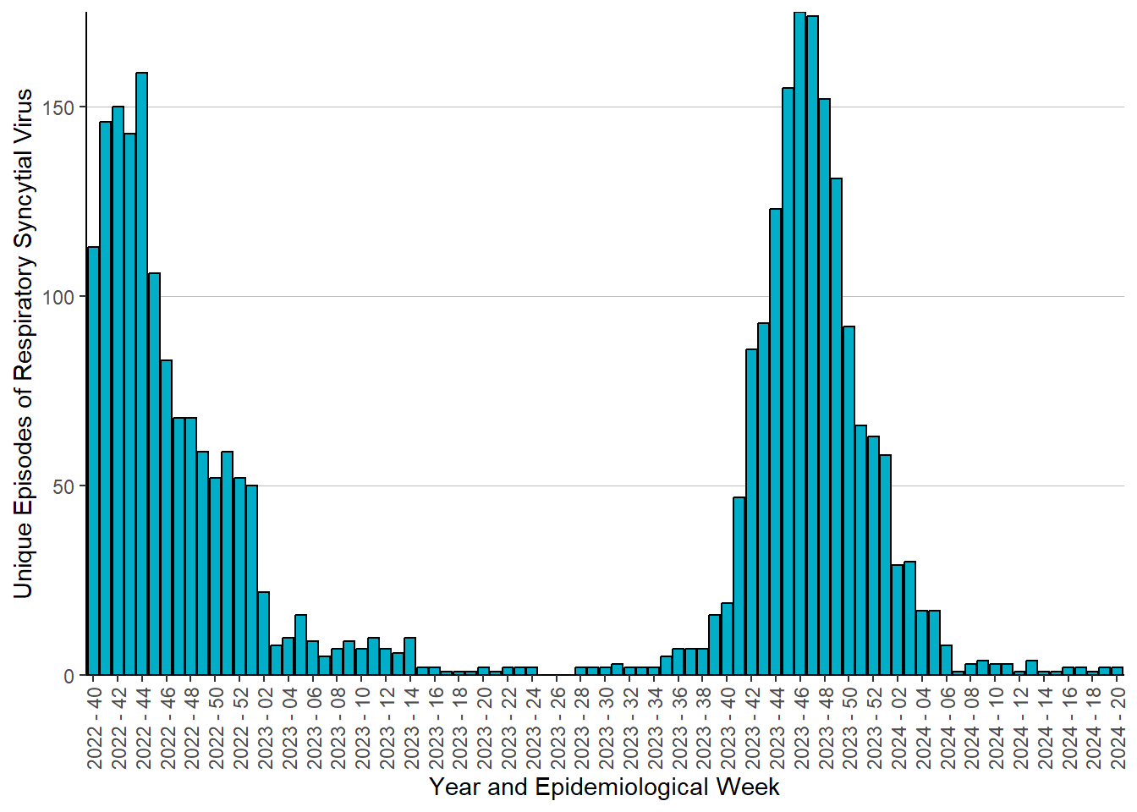
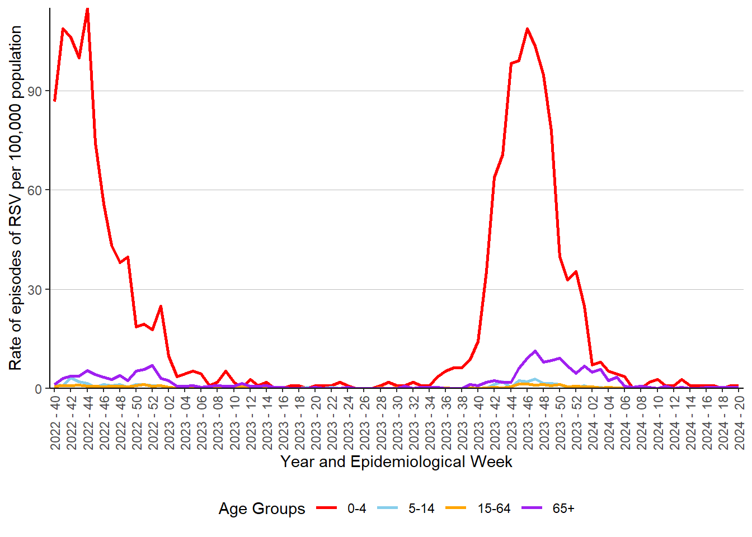
Episodes of RSV
Weekly number of unique episodes of RSV, by epidemiological week, 2022/23 – 2023/24
Weekly episode rates of RSV per 100,000 population, by age group, by epidemiological week, 2022/23 – 2023/24
In the 2023/24 influenza season:
The highest number of unique episodes was reported in week 46, 2023 (175 episodes).
1,570 episodes of RSV were identified; of which 68% were in the 0-4 age group.
Episode rates were highest in the 0-4 age group in week 46, 2023 (108.8 per 100,000 population).
Notes:
2023/24 influenza season ran from week 40, 2023 (reporting from October 2nd 2023) to week 20, 2024 (reporting to 19th May 2024).
Episodes of infection:
For RSV infection episodes, they are defined by a rolling 14-day (2-week) period from the date of the first positive test result (utilising any test method, including PCR and Point of Care Tests, or source of sample, including hospital, GP, other source). This episode begins with the earliest positive specimen date. Any subsequent positive specimen dates within 14 days for the same individual are considered part of the same episode. Positive specimens for the same individual occurring more than 14 days after the last one are counted as a separate episode.

Slide 12
RSV immunisation programme for pregnant women
Notes:
Maternal RSV immunisation programme for infant protection

Slide 13
RSV immunisation
RSV infection can occur at any age, however the risks of severe illness and complications from RSV are increased in neonates, infants and older adults.
On 7th June 2023, JCVI recommended that a universal immunisation programme should be developed to protect both infants and older adults.
From 1 September 2024, the RSV vaccine should be offered to:
all pregnant women from 28 weeks’ gestation
adults turning 75 years old
adults aged 75 years up until their 80th birthday*
The RSV vaccine should be offered throughout the year as this is a year-round programme.
Notes:
*People turning 80 in the first year of the programme will have until 31 August 2025 to get vaccinated.
The JCVI recognises that there is a significant burden of RSV illness in the UK population and unmet public health need which has a considerable impact on NHS services during the winter months.
To protect all infants, a universal year-round vaccination programme offering an RSV vaccine to all pregnant women from 28 weeks' gestation in every pregnancy will be implemented.
Respiratory syncytial virus (RSV) immunisation programme: JCVI advice, 7 June 2023 - GOV.UK (www.gov.uk)
doh-hss-md-24-2024.pdf (health-ni.gov.uk)

Slide 14
Aim of maternal RSV immunisation
the aim of the RSV vaccination programme for pregnant women is to reduce the incidence and severity of RSV disease in infants
although RSV infection can occur at any age, babies under one year of age are at greatest risk of hospitalisation and other complications
most women will have been exposed to RSV infection in childhood and in adulthood, however, the antibodies acquired from natural infection will not provide sufficient protection for their unborn babies
immunisation with the RSV vaccine during pregnancy will temporarily boost maternal antibody levels, which will enable high levels of antibodies to transfer across the placenta to the fetus, resulting in passive protection for the infant against RSV infection in the first few months of life

Slide 15
Timing of maternal vaccination
RSV is a year-round immunisation programme, and all women should be offered an RSV vaccine in every pregnancy.
Vaccination should be offered from 28 weeks' gestation (ideally in week 28 or soon after), however, women may be offered vaccination up until birth*.
Notes:
*it is clinically reasonable for women who present in labour and have not received the RSV vaccine during pregnancy to be offered the vaccine up until the time of discharge from hospital following birth, or in comparable circumstances for births outside of hospital. This will not offer passive protection to the baby through transplacental antibody transfer but may protect the mother from contracting RSV, reducing the chance of transmission to the infant, and may help increase levels of antibodies in breast milk, though neither of these is expected to be as protective a transplacental antibody transfer from vaccination earlier in pregnancy.

Slide 16
Abrysvo® RSV vaccine
Abrysvo® is a recombinant (DNA), bivalent RSV vaccine, containing recombinant RSV prefusion F protein (pre-F) antigens developed from each of the respiratory syncytial virus subtypes, A and B
Abrysvo® is the only vaccine licensed for RSV vaccination of pregnant women and it is the only RSV vaccine currently available for use in Northern Ireland
Abrysvo® is an inactivated (or non-live) vaccine
Notes:
Recombinant means a small piece of DNA from the protein of the virus is taken and inserted into a manufactured cell. As these cells grow the protein is made too. This protein is then purified and put into the vaccine which, when introduced into the body via injection, activates the immune system.
The vaccine is referred to as bivalent because it contains versions of two proteins found on the surface of the virus called ‘RSV subgroup A stabilised prefusion F’ and ‘RSV subgroup B stabilised prefusion F’.
The vaccine antigen (prefusion F proteins) stimulates the immune system to produce antibodies.
Abrysvo powder and solvent for solution for injection - Summary of Product Characteristics (SmPC) - (emc) (medicines.org.uk)

Slide 17
How the vaccine works to protect the infant
when a pregnant woman is given RSV vaccine, her immune system recognises the proteins (antigens) in the vaccine as being foreign and makes antibodies against them
these antibodies pass across the placenta and provide the baby with passive protection against RSV during their first few months of life
for the best protection, Abrysvo® is recommended for pregnant women at 28 weeks gestation, or as soon as possible after. This is to ensure enough time for the mother to make antibodies and for these to cross the placenta to help protect the baby, even if born prematurely
RSV vaccine can be offered to pregnant women up until birth, but this may not offer as high a level of passive protection to the baby
Notes:
After immunisation, it takes around two weeks for high levels of antibody transfer to the infant.
The vaccine antigen (prefusion F proteins) stimulates the immune system to produce antibodies. When the individual encounters RSV virus, the antibodies neutralise the prefusion F proteins thus preventing the virus particle from fusing with and entering the host’s cells and causing an RSV infection.
RSV vaccine can be offered to pregnant women up until birth but this may not offer as high a level of passive protection to the baby.

Slide 18
Safety of RSV vaccination in pregnancy
RSV containing vaccines are inactivated, i.e. they do not contain live organisms and cannot cause the disease against which they protect
there is no evidence of risk to pregnancy or the fetus with inactivated viral vaccines such as Abrysvo®
inactivated pertussis-containing, influenza and COVID-19 vaccines are routinely given to pregnant women with no adverse effects and with proven safety and efficacy
as of July 2024, Abrysvo® has been given to more than 100,000 pregnant women in the USA, where monitoring has shown a good safety record
Notes:
Green Book on Immunisation chapter 27a Respiratory syncyntial virus (RSV) (publishing.service.gov.uk)
RSV vaccination of pregnant women for infant protection: information for healthcare practitioners - GOV.UK (www.gov.uk)

Slide 19
Safety of RSV vaccination in pregnancy (continued)
in the vaccine clinical trials, there were slightly more premature births in the vaccine group (2.1%) compared to the unvaccinated (placebo) group (1.9%) in the month following vaccination. This was observed in upper middle-income countries, from where the data are consistent with a chance difference and was not seen in high-income countries of Europe and North America.
the difference was not statistically significant and there was no temporal relationship between vaccination and premature birth
average birth weight and gestational age at birth were the same in infants of vaccinated and unvaccinated mothers
there are no safety concerns around congenital anomalies, which were less common in the vaccine group (5%) than the placebo group (6%)
The JCVI has advised that it is reassured that the safety data for Abrysvo® does not raise any significant concerns about use in a maternal vaccination programme, and the vaccine has been approved by the Medicines and Healthcare products Regulatory Agency (MHRA) and the European Medicines Agency (EMA) on the basis of safety, quality and effectiveness.
Abrysvo® has also been licensed for use in several European countries, the USA, Argentina, Australia, Canada and Japan.
Notes:
Abrysvo® was licensed in the UK by the Medicines and Healthcare products Regulatory Agency (MHRA) in November 2023 following clinical trials.
In Northern Ireland until 31 December 2024, Abrysvo® is licensed under the European Medicines Agency (EMA) – see the SPPG/PHA PGD for further information.
The vaccine was trialled in over 4,000 pregnant women. In the trials, Abrysvo® was shown to be 70% effective at preventing severe lower respiratory tract disease caused by RSV in infants born to vaccinated mothers for at least the first 6 months of life (which is the period of time when infants are most vulnerable to severe RSV infection). There is some evidence of protection beyond this age from the same clinical trial Bivalent Prefusion F Vaccine in Pregnancy to Prevent RSV Illness in Infants. Reply - PubMed (nih.gov)
RSV vaccination of pregnant women for infant protection: information for healthcare practitioners - GOV.UK (www.gov.uk)

Slide 20
Effectiveness of RSV vaccination in pregnancy
in clinical trials, maternal (antenatal) RSV vaccination has been demonstrated to be efficacious against RSV lower respiratory tract infection (LRTI) in infants from birth through to six months of age
in the final analysis, vaccine efficacy (VE) against severe RSV LRTI was 82.4% at 90 days and 70.0% at 180 days
for maternal vaccination, while the major mechanism of infant protection is transplacental antibody transfer, some evidence suggests there may also be protective effects from antibody transfer in breast milk, and from indirect protection by reducing the risk of infection and/or degree of infectiousness in the mother and therefore chance of infecting the infant
Notes:
Lactational antibody transfer and indirect protective effects (“cocooning”) would also be expected to apply where vaccine is given too late in pregnancy for good transplacental transfer.
Green Book on Immunisation chapter 27a Respiratory syncyntial virus (RSV) (publishing.service.gov.uk)

Slide 21
Selective monoclonal antibody immunisation programme for high risk infants
RSV monoclonal antibody immunisation for passive protection of high risk infants was first approved in European countries in 1999
it is not possible to vaccinate neonates to protect them against RSV during the early months of life, as the immature immune system is not able to make an adequate response. Therefore, infants can only be protected via passive immunisation programmes
the high cost and moderate effectiveness of RSV monoclonal antibody meant that cost-effectiveness was only demonstrated for very high-risk infants
the UK selective RSV monoclonal antibody passive immunisation programme has been delivered in secondary care by paediatric services since 2010, and this programme will continue alongside the universal infant protection programme (via maternal immunisation)
RSV vaccination should be offered to all pregnant women in week 28 of pregnancy, and in addition, high-risk infants and children who meet the eligibility criteria in the Green Book RSV chapter should be offered a monoclonal antibody immunisation
Notes:
Monoclonal antibody for high-risk infants is a different product to the vaccine offered to pregnant women and older adults.
For the selective immunisation of high-risk children, monoclonal antibodies are given seasonally, usually in or from around calendar week 40 in early October.
Further information on monoclonal antibodies and the high-risk infant programme can be found in the Green Book RSV chapter.

Slide 22
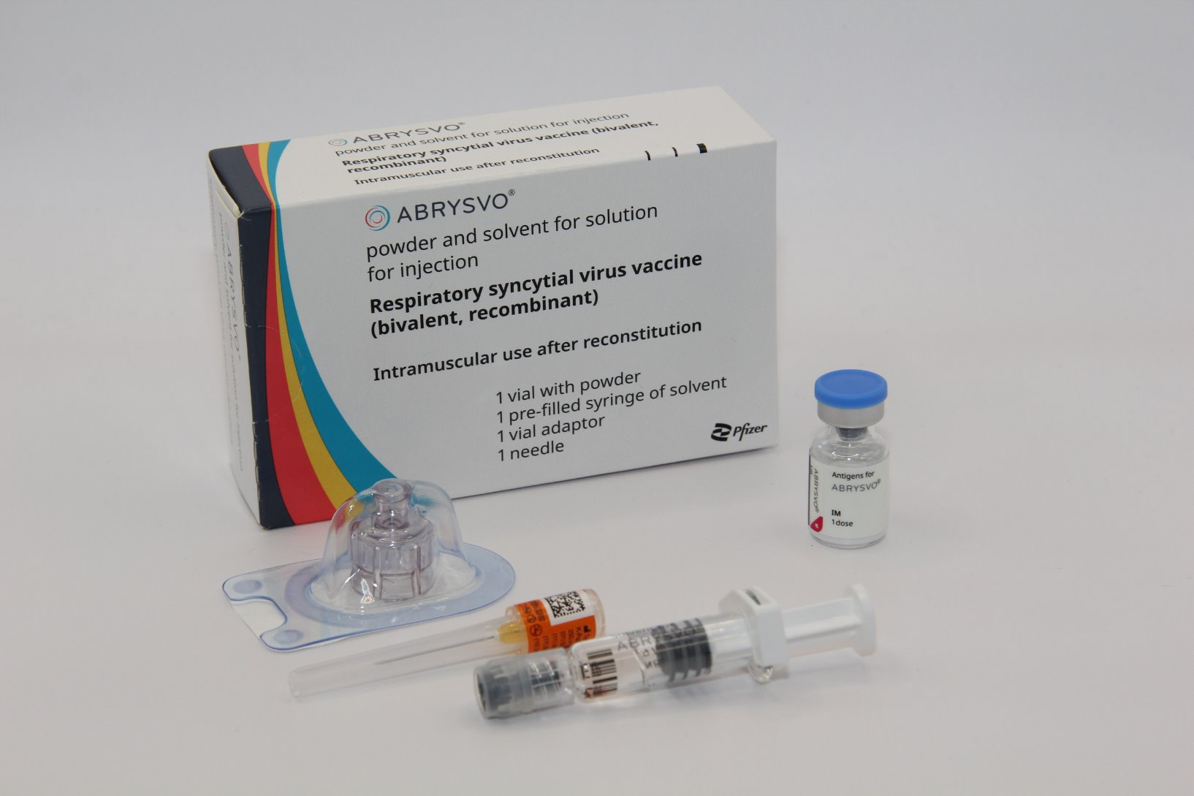
Abrysvo® respiratory syncytial virus (RSV) vaccine
Notes:
The vaccine which will be used in the universal respiratory syncytial virus (RSV) vaccination programme in Northern Ireland is Abrysvo® Pfizer RSV pre-F vaccine.

Slide 23
Vaccine pack contents
Abrysvo® is presented as a single dose pack for reconstitution.
Each pack contains:
powder for 1 dose in a vial
solvent (water for injection) in a
pre-filled glass syringe with a
stopper, luer lock adaptor and
tip cap
vial adaptor
25G 25mm needle (suitable
alternatives can be used
if required).
Notes:
The syringe stopper contains synthetic chlorobutyl rubber and the tip cap contains synthetic isoprene/bromobutyl blend rubber.
The powder is white.
The solvent is a clear, colourless liquid.
Abrysvo powder and solvent for solution for injection - Summary of Product Characteristics (SmPC) - (emc) (medicines.org.uk)

Slide 24
Contraindications and precautions
Abrysvo® should not be given to anyone who has had a confirmed anaphylactic reaction to a previous dose of an RSV vaccine, or any of the excipients (ingredients) in the vaccine
for a full list of ingredients please refer to the Summary of Product Characteristics
minor illnesses without fever or systemic upset are not valid reasons to postpone immunisation
however, if an individual is acutely unwell, immunisation may be postponed until they have fully recovered. This is to avoid confusing the differential diagnosis of any acute illness by wrongly attributing any signs or symptoms to the adverse effects of the vaccine
Notes:
There are very few individuals who cannot receive an indicated RSV vaccine or immunisation. Where there is doubt, appropriate advice should be sought from a specialist or the PHA immunisation team (pha.immunisation@hscni.net)
The Abrysvo® vaccine contains small amounts of polysorbate 80. Rarely, people may be allergic to polysorbate 80. However, polysorbate 80 is widely used in medicines and foods, and is present in many medicines including other monoclonal antibody preparations. Individuals who have tolerated injections that contain polysorbate 80 (including some COVID-19 vaccines) are likely to tolerate RSV vaccines containing polysorbate 80.
Green Book on Immunisation chapter 27a Respiratory syncyntial virus (RSV) (publishing.service.gov.uk)

Slide 25
Bleeding disorders and anticoagulation therapy
women with bleeding disorders and women who receive medication to reduce bleeding, for example treatment for haemophilia, may be vaccinated intramuscularly if, in the opinion of a doctor familiar with the woman's bleeding risk, vaccines or similar small volume intramuscular (IM) injections can be administered with reasonable safety by this route. IM vaccination can be scheduled shortly after medication/treatment is administered
women on stable anticoagulation therapy, including women who are on warfarin* who are up-to-date with their scheduled INR testing and whose latest INR is below the upper level of the therapeutic range, and women who are on prophylactic anticoagulants, such as low molecular weight heparin, can receive IM vaccination
a fine needle (23 or 25 gauge) should be used for the vaccination, followed by firm pressure applied to the site without rubbing for at least 2 minutes. The woman should be informed about the risk of haematoma from the injection
further information can be found in the Green Book, chapter four
Notes:
*Note that warfarin is not commonly prescribed for anticoagulation in pregnant women and anticoagulation may be through heparin injections.
If in any doubt regarding IM vaccination, consult with the clinician responsible for prescribing or monitoring the woman’s anticoagulant therapy.

Slide 26
Women with current or previous RSV infection
although it might be expected that a woman diagnosed with RSV infection during pregnancy would transfer some antibodies to her unborn baby, there is no assurance that the levels would be high enough to sufficiently protect the infant. As high levels of antibodies are made following vaccination, offering RSV vaccine in week 28 of pregnancy, or as soon as possible after that, should ensure that optimal antibody levels can be passed to the baby
vaccination of women who may be infected with, or incubating RSV infection can proceed, as vaccination is unlikely to have a detrimental effect on the illness
however, women currently experiencing symptoms of fever, or other systemic illness, should not attend for vaccination until they have recovered*
Notes:
*there are no safety concerns from vaccinating an individual acutely unwell with a systemic infection, however, vaccination could result in confusion between adverse reactions to the vaccine and the differential diagnosis of any acute illness therefore vaccination should be deferred until recovery from systemic illness.
Green Book on Immunisation chapter 27a Respiratory syncyntial virus (RSV) (publishing.service.gov.uk)

Slide 27
Vaccine schedule and dose
Abrysvo® should be administered from 28 weeks of pregnancy
women may still be vaccinated later in pregnancy, however, this may not offer as high a level of passive protection to the baby, therefore vaccination should ideally be offered in week 28 of pregnancy, or as soon as possible after
a single dose is 0.5 ml (the full volume of the reconstituted vaccine, drawn up by syringe)
Abrysvo ® should be administered immediately after reconstitution*, or within 4 hours if stored between 15°C and 30°C
Notes:
*the vaccine should ordinarily be used immediately after being taken from the fridge (and reconstituted), to reduce the risk of administration errors, minimise waste, and from a microbiological perspective. Chemical and physical in-use stability has been demonstrated for 4 hours between 15°C and 30°C.
Vaccination should ideally be offered in week 28 or soon after to maximise the likelihood of the baby being optimally protected from birth.
However, vaccines given to the mother close to delivery, including soon after birth, may offer indirect protection by preventing maternal infection/infectiousness and through antibody transfer in breastmilk.
Green Book on Immunisation chapter 27a Respiratory syncyntial virus (RSV) (publishing.service.gov.uk)

Slide 28
Vaccine storage
Abrysvo® should be stored in a vaccine fridge between +2°C and +8°C
the vaccine must not be frozen. Discard if the carton has been frozen
Abrysvo® should be stored in the original packaging to protect it from light
further information on vaccine storage and stability is available in the Summary of Product Characteristics (SPC) and the vaccine specific Patient Group Direction (PGD)

Slide 29
Reconstitution (preparation) of Abrysvo® vaccine
Abrysvo® must be reconstituted prior to administration by adding the entire contents of the pre-filled syringe of solvent to the vial containing the powder, using the vial adaptor.
The vaccine must be reconstituted only with the solvent provided.
Clear instructions on how to prepare the vaccine for administration can be found in the Summary of Product Characteristics and the manufacturer's video. Vaccinators are strongly encouraged to watch the video in its entirety before preparing the vaccine for the first time.

Slide 30
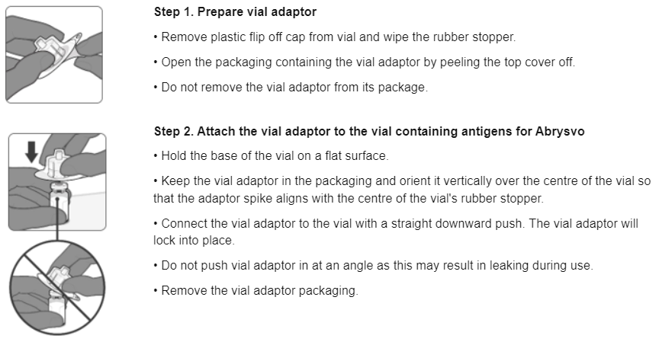
Preparing the Abrysvo® vaccine (1)
Images from Abrysvo® vaccine SPC

Slide 31
Preparing the Abrysvo® vaccine (2)

Slide 32
Preparing the Abrysvo® vaccine (3)

Slide 33
Preparing the Abrysvo® vaccine (4)

Slide 34
Co-administration with anti-D immunoglobulin, influenza and COVID-19 vaccine
where possible, vaccines should be given once a pregnant woman becomes eligible. However, there may be times when a pregnant woman presents late for vaccination, or when pregnant women may become eligible for more than one vaccine at the same time, such as during influenza and COVID-19 seasonal vaccination campaigns
Abrysvo® (RSV vaccine) can be co-administered with inactivated influenza and COVID-19 vaccines during pregnancy
in addition, there are no safety or effectiveness concerns around co-administration of Abrysvo® and the live attenuated influenza vaccine (LAIV)
Abrysvo® can be administered at the same time as, or at any interval before or after, anti-D immunoglobulin. The administration of Abrysvo® should not be delayed due to the woman receiving anti-D immunoglobulin (or vice-versa)
Notes:
Pregnant women can safely have Abrysvo co-administered with influenza vaccine, COVID-19 vaccine and/or anti-D immunoglobulin; there are no concerns around blunted responses or interactions.
If more than one injection is administered at the same time, these should be given at a separate sites, preferably in different limbs.
If given in the same limb, the injections should be given at least 2.5cm apart. The sites of each injection given should be noted in the woman's health records.
Green Book on Immunisation chapter 27a Respiratory syncyntial virus (RSV) (publishing.service.gov.uk)

Slide 35
Co-administration of RSV and pertussis vaccines
some evidence suggests that co-administration of RSV and pertussis containing vaccines may reduce the response made to pertussis components - the clinical significance of this is unclear and any impact on protection is likely to be small (the key pertussis toxoid component is least affected)
giving the vaccines separately at the routinely recommended times; from 16 - 20 weeks' gestation for pertussis (usually given around time of the fetal anomaly scan at 20 weeks), and 28 weeks' gestation for RSV, will avoid any potential attenuation (weakening) of antibody response to the pertussis containing vaccine
however, if a woman has not received a pertussis containing vaccine by the time she presents for an RSV vaccine, they can and should both be given at the same appointment to provide timely protection against both infections to the infant and to avoid the risk of the woman not returning for a later appointment
Notes:
Green Book on Immunisation chapter 27a Respiratory syncyntial virus (RSV) (publishing.service.gov.uk)

Slide 36
Breastfeeding and RSV vaccination
there is no known risk associated with giving non-live vaccines whilst breastfeeding
infants born to women who have received Abrysvo® can be safely breastfed
there may also be protective effects from antibody transfer in breast milk following vaccination during pregnancy
Notes:
No adverse effects of Abrysvo® have been shown in breastfed infants of vaccinated mothers.

Slide 37
Adverse reactions following vaccination
Vaccines can cause side effects (also referred to as adverse reactions). Reactions occur because vaccines work by triggering an immune system response. Most side effects are mild and only last a few days.
Very common side effects following RSV vaccination include:
injection site pain (41%)
headache (31%)
myalgia (muscle pains and aches) (27%).
For pregnant women, the majority of local and systemic reactions are mild in severity and resolve within a few days of onset.
Notes:
Abrysvo powder and solvent for solution for injection - Summary of Product Characteristics (SmPC) - (emc) (medicines.org.uk)

Slide 38
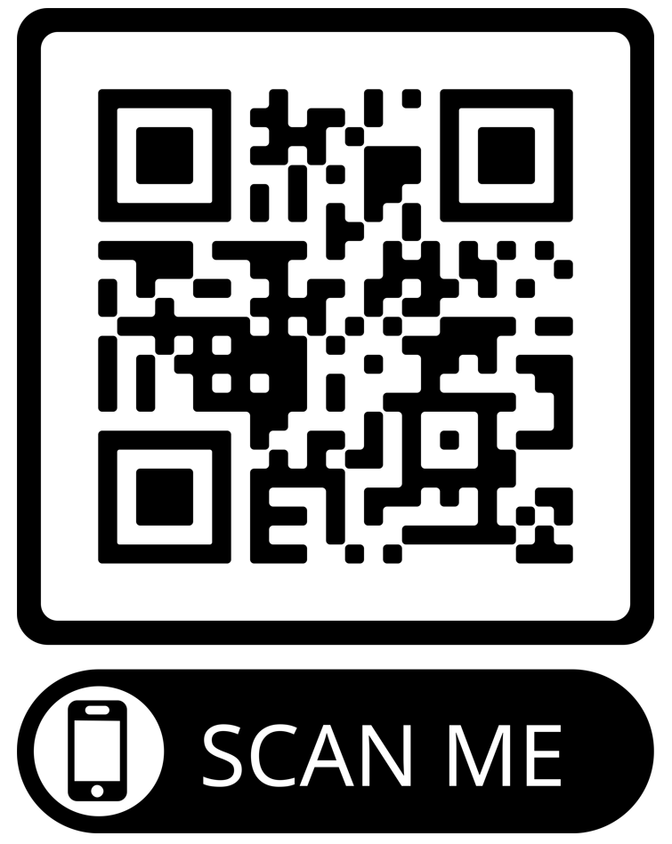
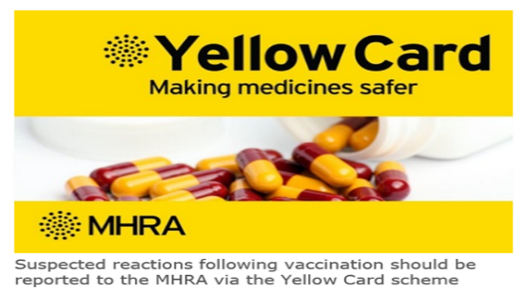
Reporting adverse reactions
Abrysvo® is a newly licensed vaccine in the UK and is subject to additional monitoring under the black triangle labelling scheme by the Medicines and Healthcare Regulatory Agency (MHRA). All suspected adverse reactions should be reported to the MHRA using the Yellow Card scheme.
Anyone (pregnant women and health care workers) can make a Yellow Card report, even if they are uncertain as to whether a vaccine caused the condition.
The QR code can be used for quick and easy access to the Yellow Card reporting site
Notes:
Vaccines are carefully monitored to ensure they are safe, not causing untoward side effects and are suitable for the immunisation programme.
MHRA promotes the collection and investigation of adverse reactions through the Yellow Card scheme which is a voluntary reporting system for suspected adverse reactions.

Slide 39
Further resources
National RSV programme guidance Green Book on Immunisation chapter 27a Respiratory syncyntial virus (RSV) (publishing.service.gov.uk)
PHA Healthcare factsheet Health professional resources | HSC Public Health Agency (hscni.net)
E-learning Immunisation - elearning for healthcare (e-lfh.org.uk)
Abrysvo® (Pfizer) vaccine preparation instructional video
UKHSA RSV vaccination programme resources Respiratory syncytial virus (RSV) vaccination programme - GOV.UK (www.gov.uk)
Medicines and Healthcare products Regulatory Agency (MHRA): reporting adverse reactions
Royal College of Midwives (RCM) Midwives and Public Health (rcm.org.uk)

