Slide 1
Band 5 AHP Regional Recruitment Workshop
Friday 1st May 2015

Slide 2
AHP Band 5 Regional Recruitment Stakeholder Workshop
Michelle Tennyson
Assistant Director of AHP & PPI
PHA
Friday the 1st of May 2015
Friday the 1st of May 2015

Slide 3
Regional Recruitment Why?
Mr David Bingham,
Chief Executive, BSO

Slide 4
How innovative recruitment solutions and working together greatly benefits all!
A Joined-Up Future for Recruitment

Slide 5
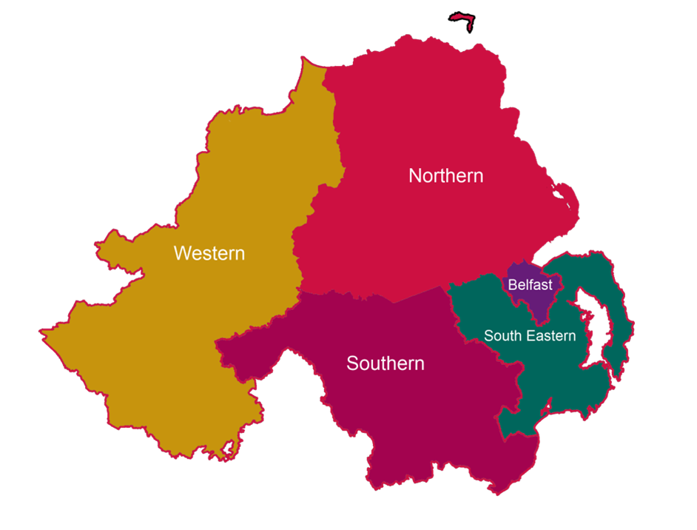
Drivers for Change
Competition for applicants
Duplication of workload
Service and cost inefficiencies
Impact on patient care

Slide 6
A Radical Rethink! – Competition to Collaboration
5 Trusts working together

