Slide 1
HPV adolescent vaccination programme August 2019

Slide 2
Aims of Resource
To support healthcare professionals in advising on and delivering the HPV vaccine.
To raise awareness on epidemiology of HPV infection.
To provide guidance on extension of the vaccination programme to include boys in 2019.
To describe details of the programme; including vaccine eligibility, dosing, schedule and contraindications or precautions.
To raise awareness on the impact of the HPV vaccination programme to date.

Slide 3
Key messages
Human papillomavirus (HPV) is responsible for over 99% of cervical cancers and there is increasing evidence of the association between HPV infection and certain anogenital and oropharyngeal cancers in both males and females.
Since the introduction of the girls vaccination programme in 2008, diagnoses of genital warts have fallen in both girls and boys, indicating herd immunity to those unvaccinated.
From 2019, the HPV vaccination programme will be extended to include boys based on JCVI recommendations.
This will prevent further spread of HPV infection and therefore more HPV-related cancers in both males and females, strengthening herd immunity.

Slide 4
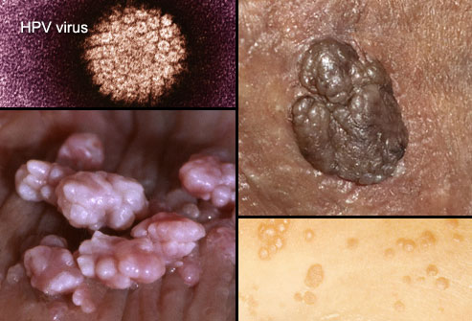
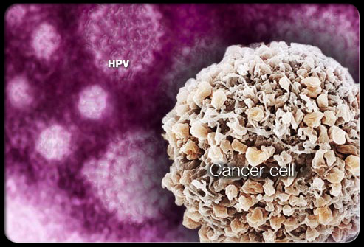
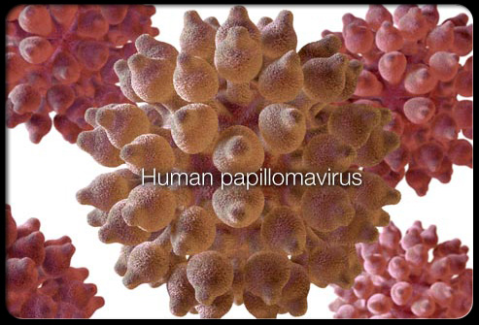
HPV

Slide 5
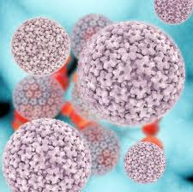
Human Papilloma Virus (HPV)
Is a double stranded DNA virus that infects skin and mucosal sites through skin-to-skin contact
Notes:
HPV is a double stranded DNA virus that infects the squamous
epithelia including the skin and mucosae of the upper respiratory
and anogenital tracts.
Spread through Skin to skin contact

Slide 6
Human Papillomavirus (HPV)
Of the +100 different types of HPV infection
- Over 40 types affect genital area.
- High risk types (16,18) cause cancer.
- Low risk types (6,11) cause genital warts.
HPV16:
HPV18:
HPV :6
HPV :11
Together account for >70% all cervical cancers –
Remaining 30% due to 13 other HPVs.
Also cancer of the anus, penis, mouth & throat, vagina & vulva
90% of cases of genital warts are due to HPV 6 and 11.
Notes:
There are over 100 different types of HPV of which 40
infect the genital area.
Genital HPVs are categorised as either
High risk types – known to be associated with cancer or
Low risk types - known to lead to the development of genital warts.
13 HPV types are known to be associated with cervical
cancer, with 2 types (HPV16 and HPV18) responsible for
More than 70% of all cervical cancers in the UK.
Types 16 and 18 are also associated with the majority of
HPV related cancers of the anus, penis, mouth and throat,
vagina and vulva.
Around 90% of cases of genital warts are thought to be
due to HPV type 6 and 11. Although they do not cause cancer,
genital warts can be difficult to treat. Some individuals may
also experience frequent recurrent episodes which may cause
significant distress to the individual and substantial costs to healthcare.

Slide 7
HPV transmission and disease
HPV is one of the most common sexually transmitted infections in UK
Nearly all sexually active people will unknowingly be infected with the virus at some point in their lives.
Most HPV infections are asymptomatic and self-limiting; with 70% of new high-risk infections clearing within 1 year and 90% of new infections clearing within 2 years.
Persistent infection can lead to lesions, warts or in some cases, HPV-related cancers.
Genital HPV infections are spread primarily by sexual contact.
Risk factors for acquiring HPV are related to sexual behaviour.
The use of condoms reduces, but does not eliminate the risk of sexual transmission.
Notes:
HPV is one of the most common sexually transmitted infections in UK
Most infections are asymptomatic and self-limiting, with most people (up to 8 out of 10) unknowingly be infected with the virus at some point in their lives.
Most HPV infections are asymptomatic and self-limiting; with 70% of new high-risk infections clearing within 1 year and 90% of new infections clearing within 2 years.
Persistent infection can lead to lesions, warts or in some cases, HPV-related cancers.
Genital HPV infections are spread primarily by sexual contact, particularly
through sexual intercourse but also by non-penetrative genital contact.
Risk factors for acquiring HPV infection are related to sexual behaviour.
Risk increases with number of new sexual partners, the sexual history of partners
and the number of previous sexual partners.
The use of condoms reduces but does not eliminate the risk of sexual transmission.
Non-sexual routes of HPV transmission include transmission from mother to baby in the
period immediately before and after birth, and hand to genital contact may explain some infections in childhood.

Slide 8
Indirect protection through reduced transmission
Notes:
In addition to direct protection to females, the current HPV programme induces herd protection, which provides substantial protection to heterosexual boys and men as long as there is high vaccine coverage in girls.
Since the introduction of the adolescent girls programme evidence has emerged that HPV immunisation is likely to provide protection against a wider range of HPV-related diseases including anal, penile and oropharyngeal cancers.
Although the girls’ programme clearly confers indirect protection through reduced transmission to heterosexual males, MSM will receive little benefit from it.

Slide 9
HPV and cervical cancer
Persistent infection with high-risk HPV is detectable in more than 99% of all cervical cancers.
The Gardasil vaccine protects against the two types of HPV infection that are found in more than 70% of cases of cervical cancer (HPV 16 and 18).
In N. Ireland there are around 88 cases of cervical cancer diagnosed each year and an average of 22 women die from the disease. Additionally, there are 1,106 cases of cervical carcinoma in-situ diagnosed here each year.

Slide 10
HPV vaccination in N. Ireland
The national HPV vaccination programme began in 2008 in the UK, initially vaccinating girls aged 12-13 years with the Cervarix vaccine.
Since 2012, the Gardasil vaccine has been used, with protection against HPV types 6, 11, 16 and 18.
In 2014, the programme was changed from a three dose to a two dose schedule (if initiated <15 years).
Since 2016, vaccination has been offered opportunistically to MSM up to 45 years through sexual health clinics.
The adolescent vaccination programme will be extended to include boys from September 2019 (JCVI recommended).
Notes:
The national immunisation programme began in 2008.
Cervarix was chosen for the initial vaccine supply. When this was reviewed in 2011,
Gardasil offered the best value and so was chosen for the next contract and has been used since 2012, giving protection against HPV 6,11,16,18.
In September 2014 the programme changed, from a three dose to a two dose schedule,
provided vaccination is initiated prior to 15 years of age.
A 3 dose schedule remains necessary if immunisation is initiated after the females’ 15th birthday.
Since 2016, the HPV vaccine has also been offered to MSM up to 45 years through sexual health clinics.

Slide 11
Why the vaccine programme is being extended to include boys
In June 2018 a JCVI HPV sub-committee met to consider the association of HPV with non-cervical cancers that affect men as well as women.
They recommended vaccinating adolescent males would provide clear health benefits, including:
- Direct protection for vaccinated boys against HPV infection and associated disease;
- Optimising protection against HPV for MSM by offering them vaccination before their sexual debut;
- Indirect protection to non-vaccinated girls and boys.
Notes:
Extending the HPV vaccine programme to boys aged 12 to 13 will prevent more HPV-related cancers and reduce the overall burden of these cancers sooner than a girls only programme would do.
A programme for boys and girls will also provide resilience against any short term fluctuations in vaccine uptake and will contribute to better control of the main cancer causing types of HPV.
There will not, however, be a catch up programme for boys outside of the eligible age range because:
High uptake of HPV vaccine among girls over the last ten years has reduced the prevalence of the types of HPV that the vaccine protects against.
The risk of unvaccinated boys and girls coming into contact with HPV viruses, and passing them on, is now lower than before 2008.
The number of diagnoses of genital warts has also fallen in both girls and boys since the programme started, which also suggests that boys are benefiting indirectly from the girls’ programme through ‘herd protection’.
This means there is not as strong a case for a catch-up programme for older boys as there was for the girls and there would be limited additional benefit.

Slide 12
HPV associated cancers in men
In men, HPV infection is associated with:
-80-85% of anal cancers;
-28% of a subset of oropharyngeal cancers;
-50% of penile cancers.
MSM who attend GUM, sexual health and HIV services experience higher rates of HPV infection and related cancers:
-HPV 16-associated anal cancers are much more common in MSM compared with heterosexual men;
-The incidence of anal cancer is highest in HIV positive MSM;
-Some MSM have high-risk sexual behaviour;
-Would benefit from direct effect of the vaccine.

Slide 13
HPV epidemiology before introduction of the national screening programme in 2008
Low HPV prevalence in girls aged 14 years.
HPV infection rises sharply from 14 years onwards until the early 20s.
- 11% show evidence of HPV type 6
- 3% show evidence of HPV type 11
- 12% show evidence of HPV type16
- 5% show evidence of HPV type 18
*Source: UK Seroprevalence study (2007)
Notes:
Surveillance of HPV is complex due to the high proportion of asymptomatic infections,
the variable presentation of the different viral types and the long period between infection & disease.
A UK seroprevalence HPV study conducted in 2007, before the introduction of the vaccination programme, in an unselected population showed that
HPV infection was extremely infrequent in girls aged under 14 years but rose sharply
from age 14 years onwards, until the early 20s, and then stabilized or declined.
- 11% show evidence of HPV type 6
- 3% show evidence of HPV type 11
- 12% show evidence of HPV type16
- 5% show evidence of HPV type 18

Slide 14
Impact of the vaccination programme on HPV infection

Slide 15
Individual type-specific prevalence among 16-18 year old females in England
Notes:
Study carried out in England in 2008 to determine the prevalence of
human papillomavirus (HPV) infections in sexually active adolescents and young women,
prior to widespread HPV immunisation.
Approximately 18% of the sample where infected with high risk HPV types.

Slide 16
Changes in post-vaccination HPV (16 &/or 18) prevalence in England: 16-18 year old females
Notes:
This figure shows data on HPV 16 AND/OR 18 prevalence in 16-18 year old females, in the post-vaccination period over time, to 2016.
The prevalence of HPV 16 and/or 18 has decreased within the post-vaccination period over time, from 8.2% in 2010 to 1.6% in 2016. These decreases were strongly associated with the increasing estimated vaccination coverage.

Slide 17
Pre and post vaccine HPV prevalence in 20 year old females entering the cervical screening programme in Scotland
HPV 16/18 prevalence reduced from 30.0% (26.9, 33.1%) in 1988 cohort to 4.5% (3.5, 5.7%) in the 1995 (routine) cohort
HPV 31/33/45 prevalence reduced from 14.2% (12-16.7%) in the 1988 cohort to 2.6% (95% CI: 1.9-3.6%) in the 1995 (routine) cohort
Other HR-HPV - no significant changes
Notes:
Results from Scotland show a reduction in prevalence from 30% in the 1988 cohort to 4.5% in the 1995 cohort for HPV types 16 and 18
Interestingly, there was also a reduction in prevalence of HPV types 31/33/45 (in red) from 14.2% in the 1988 cohort to 2.6% in the 1995 cohort (not in the Gardasil vaccine, suggestive of potential cross protection from the vaccine).
Kavanagh K, Pollock KG, Cuschieri K, Palmer T, Cameron RL, Bhatia R, Moore C, Cubie H, Cruickshank M, Robertson C. Lancet Infect Dis. 2017 Sep 28. pii: S1473-3099(17)30468-1

Slide 18
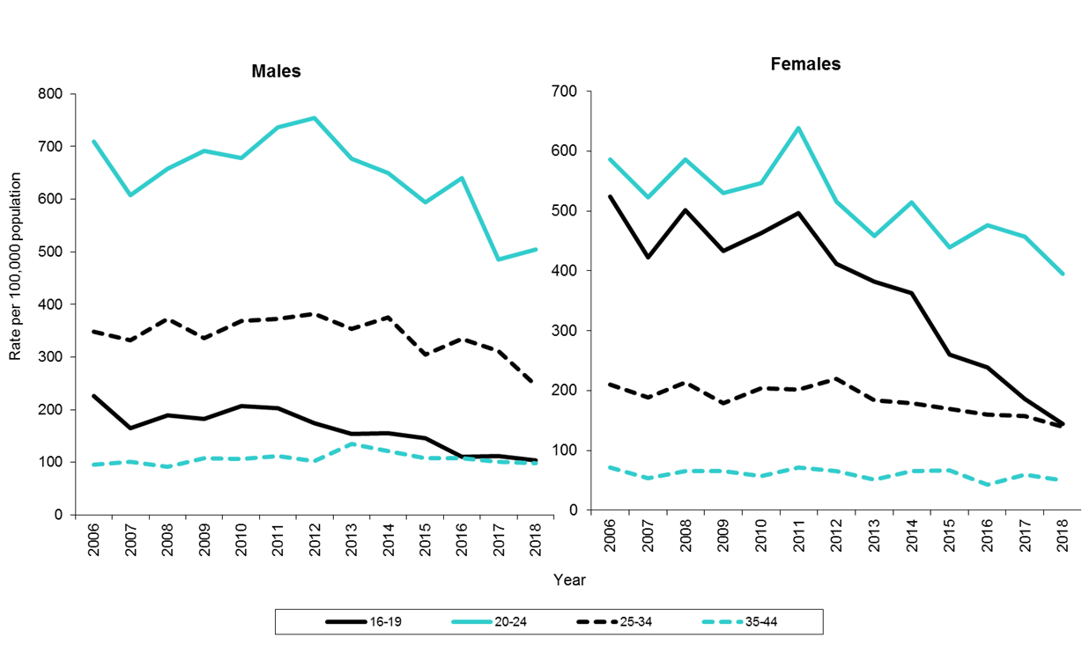
Notes:
One of the key successes of the vaccination programme is the strong evidence of herd protection from the high coverage female programme, associated with reductions in genital wart diagnoses in males and females in the UK.s
These graphs show rates of diagnosis of genital warts (first episode) in Northern Ireland, by age and gender, 2006–2018
The decline in diagnostic rates has been greatest in females aged 16-19 years (48%) followed by females aged 20-24 years (32%). (solid lines)
There have also been declines in diagnostic rates in males aged 16-19 years (29%) and 20-24 years (20%).
It is likely that this pattern in females is at least partly explained by an unexpected direct protective effect from the bivalent vaccine introduced in 2008, with a smaller indirect effect being seen in males.

Slide 19
Impact on cervical disease
The full impact of the HPV vaccination programme on cervical cancer is yet to be fully realised, as the first cohort of routinely vaccinated adolescent girls only became eligible for cervical screening.
Emerging global evidence using population-based surveillance suggests that vaccination is strongly associated with a reduction in both low and high grade cervical abnormalities (CIN of grade 1 or worse) in young women
Scotland began cervical screening at the age of 20 years (although this was amended to age of 25 years in June 2016)
Girls immunised as part of the catch-up cohort have been entering the cervical screening programme since 2011
Notes:
The full impact of the HPV vaccination programme on cervical cancer is yet to be fully realised, as the first cohort of routinely vaccinated adolescent girls only became eligible for cervical screening.
Emerging global evidence using population-based surveillance suggests that vaccination is strongly associated with a reduction in both low and high grade cervical abnormalities (CIN of grade 1 or worse) in young women
Scotland began cervical screening at the age of 20 years (although this was amended to age of 25 years in June 2016)
Girls immunised as part of the catch-up cohort have been entering the cervical screening programme since 2011

Slide 20
Disease Percentage of 20 year old women diagnosed with CIN 2/CIN3+ by birth cohort
Vaccine associated with 88% and 94% reduction in CIN2 and 3+ at population level
Biggest reduction in disease in more deprived women
1.0
4.2
35.6
65.2
69.3
70.1
86.5
Vaccine uptake 3-doses (%)
Notes:
The percentage of 20 year old girls with CIN2 or 3+ has declined with time by birth cohort and with increasing percentage vaccine uptake achieved, as shown by the graph in the red line and blue line respectively as an 88% and 94% reduction.
The reduction was greater in more deprived women.

Slide 21
Hpv vaccine

Slide 22
Recommended HPV Vaccine: Gardasil
Brand name: Gardasil
Generic name: Human papillomavirus vaccine (Quadrivalent)
HPV types 6,11,16 and 18
Type of vaccine: Recombinant, absorbed
Approved for use in males and females from 9 years old
Very high efficacy shown in clinical trials and well tolerated
- Over 99% effective preventing pre-cancerous lesions associated with types 16 and 18.
- Also 99% effective at preventing genital warts associated with types 6 and 11.
Notes:
Gardasil 4 HPV types (6,11,16 and 18) = quadrivalent vaccine (previously bivalent vaccine Cervarix was used – no longer stocked)
Approved for use in males and females from 9 years old
Very high efficacy shown in clinical trials and well tolerated
Over 99% effective preventing pre-cancerous lesions associated with types 16 and 18.
Also 99% effective at preventing genital warts associated with types 6 and 11 in young women.

Slide 23
HPV Vaccines
Made from the proteins of the outer coat of virus types.
Inactivated vaccine so cannot cause the disease against which it prevents.
Highly immunogenic.
A clinical trial of Gardasil in males indicated it can prevent anal cell changes caused by persistent infection, and genital warts.
May boost immunity and prevent reinfection or reduce recurrences in people with previously treated high-grade anal intra-epithelial neoplasia diseases.
Notes:
HPV vaccines are a sub-unit vaccine which means they use only part of a target HPV virus.
Virus-like particles (VLPs) are prepared from recombinant proteins grown in either yeast or baculovirus infected insect cells.
These VLPs contain no genetic material from the HPV viruses and can’t cause illness, but prompt an immune response that provides future protection against HPV.
Highly immunogenic.
A clinical trial of Gardasil in males indicated it can prevent anal cell changes caused by persistent infection, and genital warts.
May boost immunity and prevent reinfection or reduce recurrences in people with previously treated high-grade anal intra-epithelial neoplasia diseases.
Swedish KA, Factor SH, Goldstone SE. Prevention of recurrent high-grade analneoplasia with quadrivalent human papillomavirus vaccination of men who have sexwith men: a nonconcurrent cohort study. Clin Infect Dis. 2012;54:891-8.Available at https://www.ncbi.nlm.nih.gov/pubmed/22291111 [Accessed by PHE on 29th May 2019]

Slide 24
HPV vaccine
The vaccine is now used in more than 120 countries around the world including the USA, Canada, Australia and most of Western Europe, with more than 80 million people having been vaccinated.
In the UK, since the start of the programme in 2008, more than 10.5 million doses have been given.
Most women aged 15 – 24 years in the UK, have now been vaccinated.
It is expected the vaccine will save hundreds of lives per year in the UK.

Slide 25
Gardasil vaccine safety
The safety of the Gardasil vaccine has been established through rigorous testing in clinical trials, followed by the use of millions of doses across the world.
Since 2012 in the UK, more than three quarters of a million girls have received the Gardasil vaccine.
Some people may experience mild side-effects, generally of short duration, far outweighed by the expected benefits of the vaccine.
The UK Medicines and Healthcare products Regulatory Agency (MHRA) have established extensive reviews of HPV vaccine safety (www.mhra.gov.uk/HPVvaccine).
US health authorities have also posted very clear advice on their website supporting the safety of the vaccine (www.cdc.gov/vaccinesafety/Vaccines/HPV/index.html).

Slide 26
Vaccine safety reviews
JCVI carried out a routine review of HPV vaccine safety in 2015 and concluded it had no concerns about the vaccine safety.
Extensive reviews of HPV vaccine safety have also been undertaken by independent health bodies & authorities worldwide.
ALL conclude the evidence does not support a link between HPV vaccine and development of a range of chronic illnesses:
MHRA
World Health Organization’s Global Advisory Committee on Vaccine Safety
European Medicines Agency
US Centre for Disease Control and Prevention
Health Canada

Slide 27
Gardasil Vaccine Schedule
Individuals under 15 years of age:
Gardasil can be administered as a 2 dose schedule of 0.5ml.
- Second dose should be administered at least 6 months after first.
- 6 – 24 months clinically acceptable.
- As long as first dose is received before 15 years of age the 2 dose schedule can be followed.
Individuals 15 years of age and older:
Gardasil should be administered as a 3 dose schedule of 0.5ml.
- Second dose should be administered at least 1 month after first.
- Third dose should be administered at least 3 months after second.
- All 3 doses should ideally be given within one year.
- A 24 month period is clinically acceptable.
Notes:
Schedule for Gardasil
First dose of 0.5ml Gardasil HPV vaccine. Second dose 0.5ml at least 6 to 24 months after first dose .
Three dose schedule (> 15 years)
First dose of 0.5ml of Gardasil® HPV vaccine.
Second dose of 0.5ml at least one month after the first dose and
a third dose of 0.5ml at least three months after the second dose.
Vaccination is now covered by the national HPV vaccination programme for eligible cohorts, up to the age of 25 years.
If a person receives their first dose before turning 25, the course should be completed as per schedule.

Slide 28
Gardasil vaccine schedule cont.
Vaccination is now covered by the national HPV vaccination programme for eligible cohorts, up to the age of 25 years.
If a person receives their first dose before turning 25, the course should be completed as per schedule.
Recent studies indicate that for individuals under 15 years of age, a two dose course, given a minimum of six months apart induces the same protection.
Prior infection with one HPV type does not diminish the efficacy of the vaccine against other HPV types included in the vaccine.
Efficacy studies have shown the vaccine offer protection for at least ten years, with no evidence of waning immunity.
Notes:
Current studies suggest that protection is maintained for at least ten years. Based on the immune responses, it is expected that protection will be extended further; long-term follow-up studies are in place to evaluate this and will determine the need for any subsequent boosters.

Slide 29
Gardasil vaccine schedule cont.
If the course is interrupted, resume, do not repeat doses, allow appropriate intervals between remaining doses.
To get the best protection, it is important the full course of vaccination is received; 2 or 3 doses depending on when the first dose was received.
Although it is unlikely, as the vaccine no longer in stock here, if immunisation was commenced using Cervarix, the course can be completed using Gardasil.
Notes:
If course is interrupted, resume, do not repeat doses, allow appropriate intervals between remaining doses.
Complete the course using the 0, 1, 4-6 or 0, 6-24 months schedule depending on the age of the individual when he or she received the first dose and whether one or two doses have already been given.
The individual must complete the full 2 or 3 dose course to ensure they are fully protected.
Those who commenced HPV immunisation using Cervarix® can complete the course using Gardasil.

Slide 30
Administration of Gardasil
Gardasil should only be administered using a:
Prescription written manually or electronically by a registered medical practitioner or other authorised prescriber.
Patient Specific Direction (PSD)
Patient Group Direction (PGD)
Providers may chose to source their own PGDs locally or to prescribe the vaccine on an individual level using a PSD.

Slide 31
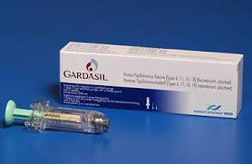
Administration of Gardasil cont.
The vaccine comes as a pre-filled suspension that must be shaken before use to form a white suspension.
Two separate needles are available with the pre-filled syringe.
Should be given by intramuscular injection into the deltoid muscle.
For individuals with a bleeding disorder, Gardasil should be given by deep subcutaneous injection to reduce the risk of bleeding.
Vaccine can be given at the same time
as other national schedule vaccines.
Notes:
Gardasil® is presented as a suspension, shake before use to form a white cloudy liquid
Gardasil® is given by intramuscular injection into the deltoid.
However, for individuals who have a bleeding disorder, vaccines should be given
by deep subcutaneous injection to reduce the risk of bleeding.
Can be given at the same time as other vaccines e.g. Td/IPV, MMR and Hepatitis B vaccines.
Give in separate sites preferably in a different limb. If given in the same limb, vaccines should be
administered 2.5cm apart and the site of administration should be documented.

Slide 32
Contraindications and precautions to Gardasil
Gardasil should not be administered to those who have had a
- Confirmed anaphylactic reaction to a previous dose of the vaccine.
- Confirmed anaphylactic reaction to any component of the vaccine.
Immunisation should be deferred in
- Cases of fever or acute illness
- Pregnancy
Note: yeast allergy is not a contraindication to the HPV vaccine. Even though Gardasil is grown in yeast cells, the vaccine product does not contain any yeast.
Notes:
There are very few individuals who cannot receive HPV vaccines. Where there is doubt, instead of withholding immunisation, appropriate advice should be sought from a consultant with immunisation expertise, a member of the screening and immunisation team or from the local health protection team.
A mild fever or upper respiratory infection (for example cold) itself is not a reason to delay vaccination.
If acutely unwell, the immunisation may be deferred until the individual has recovered – this is to avoid confusing the differential diagnosis of acute illness by wrongly attributing signs or symptoms as adverse effects of the vaccine.
For the composition and full list of excipients of the vaccine, please refer to the manufacturer’s Summary of Product Characteristics (SPC).

Slide 33
Possible adverse reactions
Vaccines undergo rigorous safety testing as part of licensing process.
Most common adverse reactions after HPV vaccination are usually mild to moderate in intensity and include:
- Injection site reactions, such as pain, redness or swelling
- Systemic reactions, such as headache, fatigue, muscle aches, low grade fever
- Anaphylaxis is possible but extremely rare
Notes:
Vaccines undergo rigorous safety testing as part of the licensing process.
The safety of HPV vaccines was tested in thousands of volunteers before the vaccines were approved.
All international bodies have continually reported that HPV vaccines are safe with no known long‐term side effects.
Most common adverse reactions after HPV vaccination include:
- Mild to moderate pain at injection site
- Redness and immediate localised stinging at the injection site
- Headache, fatigue, muscle aches, low grade fever
- Anaphylaxis is possible but extremely rare

Slide 34
Reporting adverse reactions
Yellow card scheme
Voluntary reporting system for suspected adverse reaction to medicines/vaccines.
Success depends on early, complete and accurate reporting.
Report even if uncertain about whether the vaccine caused condition.
http://mhra.gov.uk/yellowcard
See Chapter 8 of the Green Book
for details.

Slide 35
Immunosuppression and HIV
A 3 dose schedule should be used for individuals known to be HIV-infected, regardless of CD4 count and including those on antiretroviral Rx, or known to be immunocompromised at the time of immunisation.
HPV vaccines are known to be safe and immunogenic for individuals infected with HIV although the immune response and its effectiveness may be less than that observed among those who are not HIV infected.
Re-immunisation should be considered after completion of treatment or recovery and specialist advice sought.
Notes:
There is no data for two dose schedules for immunocompromised individuals.
Therefore a 3 dose schedule should be used for females known to be HIV-infected,
including those on antiretroviral Rx, or known to be immunocompromised at the time of immunisation.
Re-immunisation should be considered after completion of treatment or recovery
and specialist advice should be sought.

Slide 36
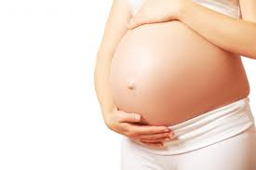
Pregnancy and breastfeeding
If a female finds out she is pregnant after starting a course of HPV vaccine she should continue her pregnancy and complete the 3 dose HPV vaccine schedule after delivery.
Routine questioning about pregnancy
or LMP is not required
before offering vaccine.
Notes:
If patient finds out she is pregnant after starting a course of HPV vaccine she should continue her pregnancy a
nd complete the 3 dose HPV vaccine schedule after delivery. This precautionary advice is based on lack of
data regarding HPV vaccination during pregnancy rather than any known risk.
Inactivated vaccines are not a risk in pregnancy however as a precaution HPV vaccine is not recommended in pregnancy.
Routine questioning about pregnancy or LMP is not required before offering vaccine.

Slide 37
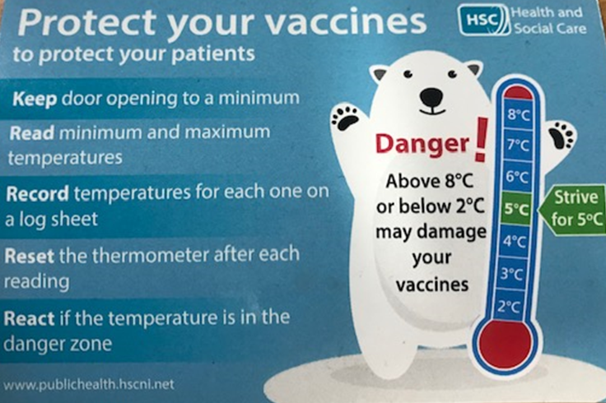
Storage of Gardasil
Store between +2 and +8°C
Store in original packaging
Protect from light
Effectiveness cannot be guaranteed for vaccines unless the cold chain has been maintained and vaccine has been monitored as per national recommendations

Slide 38
Vaccine stock management
All providers should:
Review available fridge space to ensure adequate storage capacity before ordering new vaccine
Ensure that there is enough stock for 2 to 4 weeks of use and not over order
Have local protocols in place to reduce vaccine wastage to a minimum and protect vaccines in the event of a cold chain incident.
Report any cold chain failures or vaccine wastage through the Public Health Agency duty room (0300 555 0119).
Small percentage reductions in vaccine wastage will have a major impact on the financing of vaccine supplies.
Notes:
Give details of where to contact in the case of cold chain breech

Slide 39
Potential implications for cervical screening programmes?
Cervical screening programmes will be reviewed in the future to accommodate increasingly vaccinated women where disease will be rare.
A new modelling study suggests that vaccinated women may only need three cervical screens in their lifetime (rather than the current 12 lifetime screens).
At present cervical screening programmes remain unchanged given the existent population unvaccinated.
Information on vaccination status is essential.
Notes:
Cervical screening programmes will be reviewed in the future to accommodate increasingly vaccinated women where disease will be rare.
A new modelling study suggests that vaccinated women may only need three cervical screens in their lifetime (rather than the current 12 lifetime screens).
At present cervical screening programmes remain unchanged given the existent population unvaccinated.
Information on vaccination status is essential.

Slide 40
Attitudinal survey (Eng): 13-15 year olds and their parents
1,306 interviews across England (654 parents & 652 young people)
Key findings and messages:
Schools and health professionals trusted sources of information
Young people who had received information about vaccines were more likely to consider them important
Most teenagers believe vaccines to be safe and effective
Social media had less of an influence than expected
Essential that the HPV information leaflet is sent out with the consent form to all parents/teenagers
Parents and teenagers generally agree
Notes:
This attitudinal survey was carried out across England, with 1,306 interviews of 13-15 year olds and their mothers (roughly 50/50).
The key findings are interesting and include:
Schools and health professionals are the most trusted sources of information
Young people who had received information about vaccines were more likely to consider them important
Most teenagers believe vaccines to be safe and effective
Social media had less of an influence than expected
Essential that the HPV information leaflet is sent out with the consent form to all parents/teenagers as they do read it and found it important
Parents and teenagers generally agree and disagreements regarding the vaccine were not often reported

Slide 41
HPV vaccine uptake

Slide 42
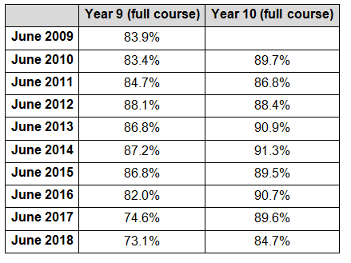
HPV vaccination uptake rates in Northern Ireland,
year 9 & 10 girls completing full course, 2009-2018
Source: Northern Ireland Child Health System

Slide 43
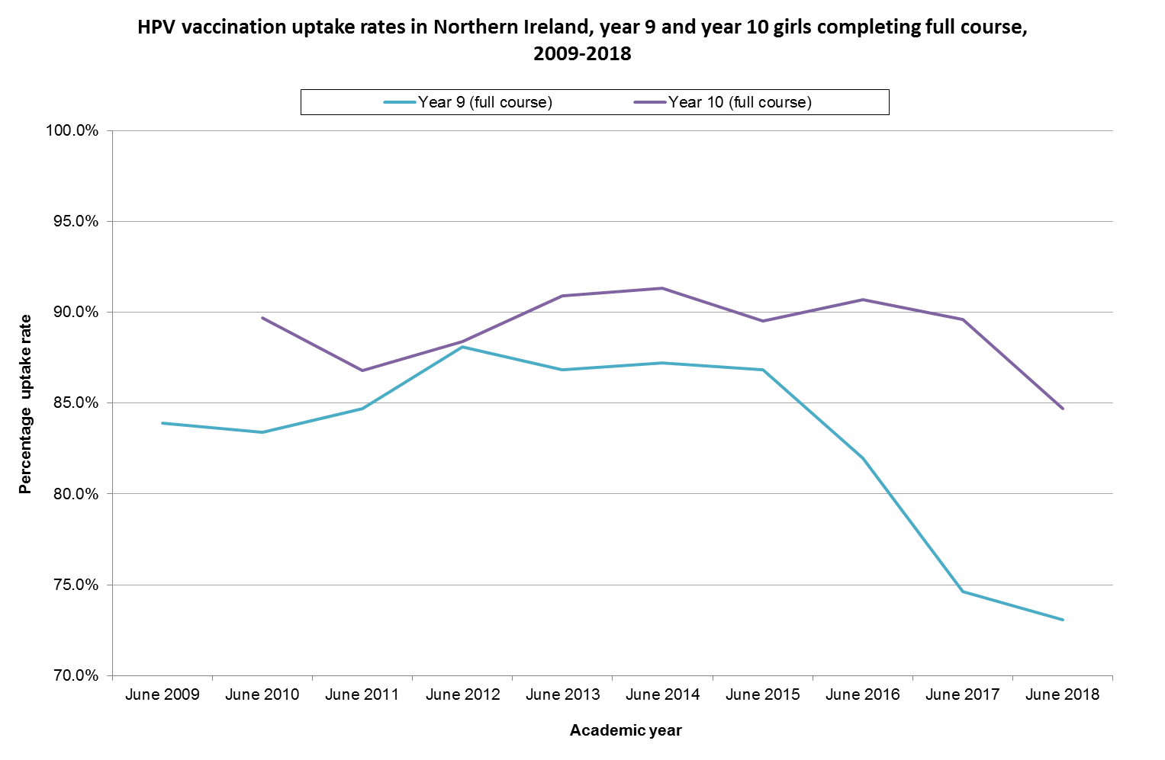
Notes:
The uptake of a completed course by the end of Year 9 has fallen somewhat since a maximum in 2012, but due to further clinics being offered in Year 10, more than 90% of girls had completed the course by the end of Year 10 in June 2016

Slide 44
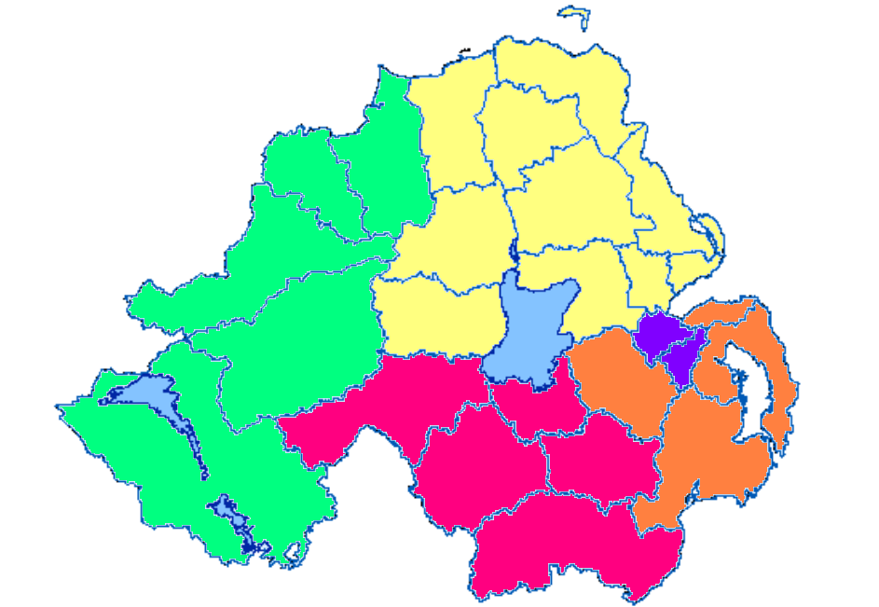
HPV vaccination uptake rates in Northern Ireland, year 9 girls
completing dose 1, by trust, 2016-17 and 2017-18
Northern Trust (NHSCT) – 85.0% (86.5%)
Belfast Trust (BHSCT) – 83.9% (85.9%)
South Eastern Trust (SEHSCT) – 80.1% (84.9%)
Southern Trust (SHSCT) – 76.5% (75.0%)
Western Trust (WHSCT) – 78.5% (79.5%)
*2016-17 data in brackets ( )
NHSCT
85.0%
(86.5%)
BHSCT
83.9%
(85.9%)
WHSCT
78.5%
(79.5%)
SEHSCT
80.1%
(84.9%)
SHSCT
76.5%
(75.0%)

Slide 45
HPV MSM
Heterosexual males gain herd protection from the girls programme, but MSM do not.
From Oct 2016, HPV vaccine has been offered through sexual health clinics to MSM under 45
3 dose schedule

Slide 46
Key messages
The HPV vaccine is not new! There has been a high uptake in over 120 countries around the world to date and millions of doses have been administered safely.
Emerging evidence from the UK and around the world that HPV vaccine works and that high coverage in girls is having significant herd effects (in unvaccinated girls and boys).
Vaccine coverage has declined nationally in recent years and it is important to try and unpick local issues and address them, as this vaccine will save many lives.
There are high levels of trust in the programme, healthcare workers and materials and leaflets are still very important.

Slide 47
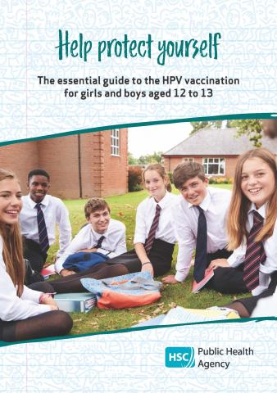
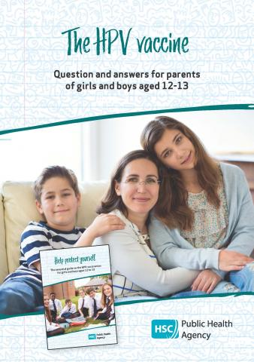
Resources
Health professionals
Green Book chapter
PGD
Factsheet for healthcare professionals
(PHA website)
Parents and young people
Leaflets
Record card
Online resources
(PHA website and NI direct)

